Slide 1
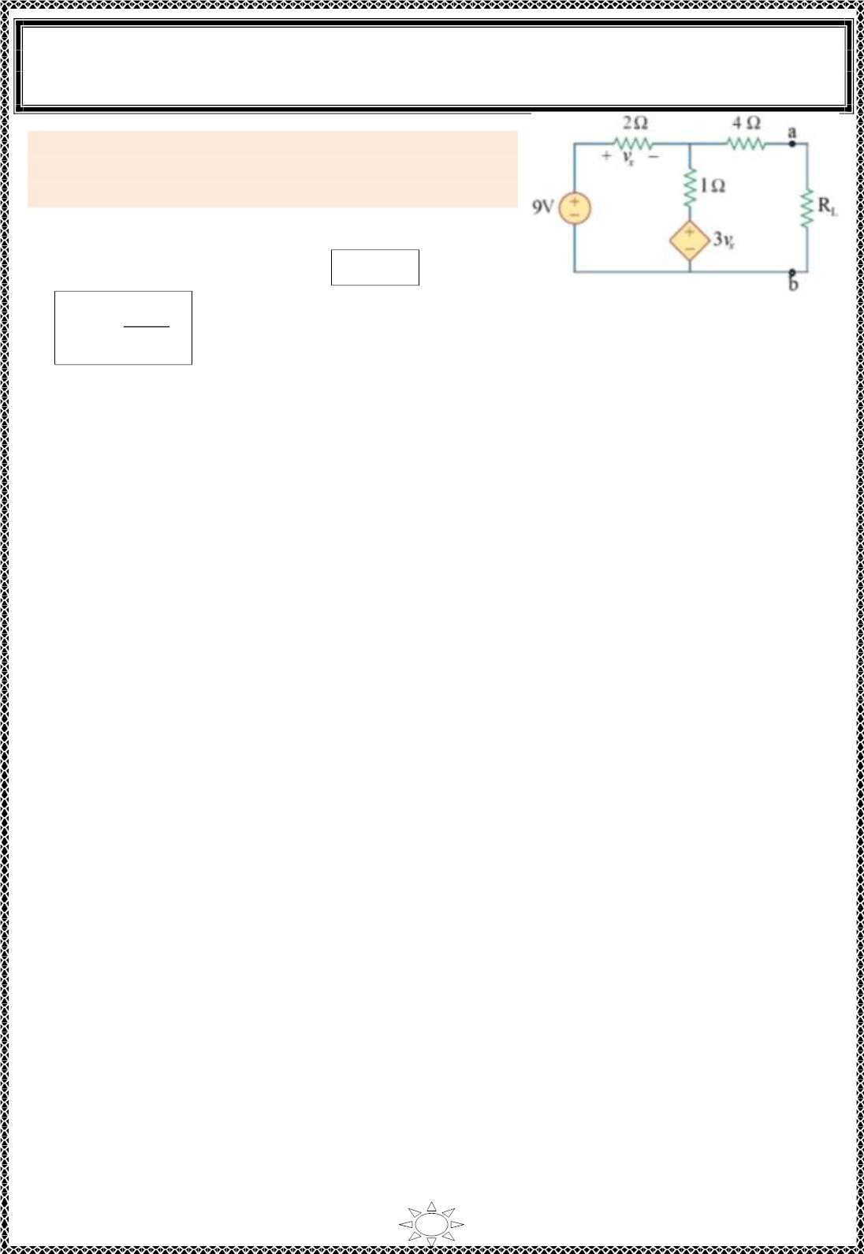
University of Diyala
Engineering College
Electronic Department
Electrical Engineering Fundamentals
1st Class
Asst., Lecturer : Wisam N. AL-Obaidi
Year (2013-2014)
Example 2: Determine the value of R_{L} that will draw
maximum power from the rest of the circuit shown.
Also c alc u late the ma x imum power.
Solution:
For maximum power transferred, R_{L} = R_{Th}
2
^{V}Th
& P =
Figure (9.6)
max
4R_{Th}
So we must find R & V .
Th
Th
Trail Version
Trail Version
Trail Version
Trail Version
Trail Version
Trail Version
Trail Version
Trail Version
Trail Version
Trail Version
Trail Version
Trail Version
Trail Version
91

